Slide 1
Chapter 3
Transport Layer
UDP & QUIC

Slide 2

Chapter 3: roadmap
Transport-layer services
Multiplexing and demultiplexing
Connectionless transport: UDP
Principles of reliable data transfer
Connection-oriented transport: TCP
Principles of congestion control
TCP congestion control
Evolution of transport-layer functionality

Slide 3



UDP: User Datagram Protocol
Why is there a UDP?
“no frills,” “bare bones” Internet transport protocol
“best effort” service, UDP segments may be:
  lost
  delivered out-of-order to app
no connection establishment (which can add RTT delay)
simple: no connection state at sender, receiver
small header size
no congestion control
  UDP can blast away as fast as desired!
  can function in the face of congestion
connectionless:
  no handshaking between UDP sender, receiver
  each UDP segment handled independently of others

Slide 4

UDP: User Datagram Protocol
UDP use:
  streaming multimedia apps (loss tolerant, rate sensitive)
  DNS
  SNMP
  HTTP/3
if reliable transfer needed over UDP (e.g., HTTP/3):
  add needed reliability at application layer
  add congestion control at application layer

Slide 5
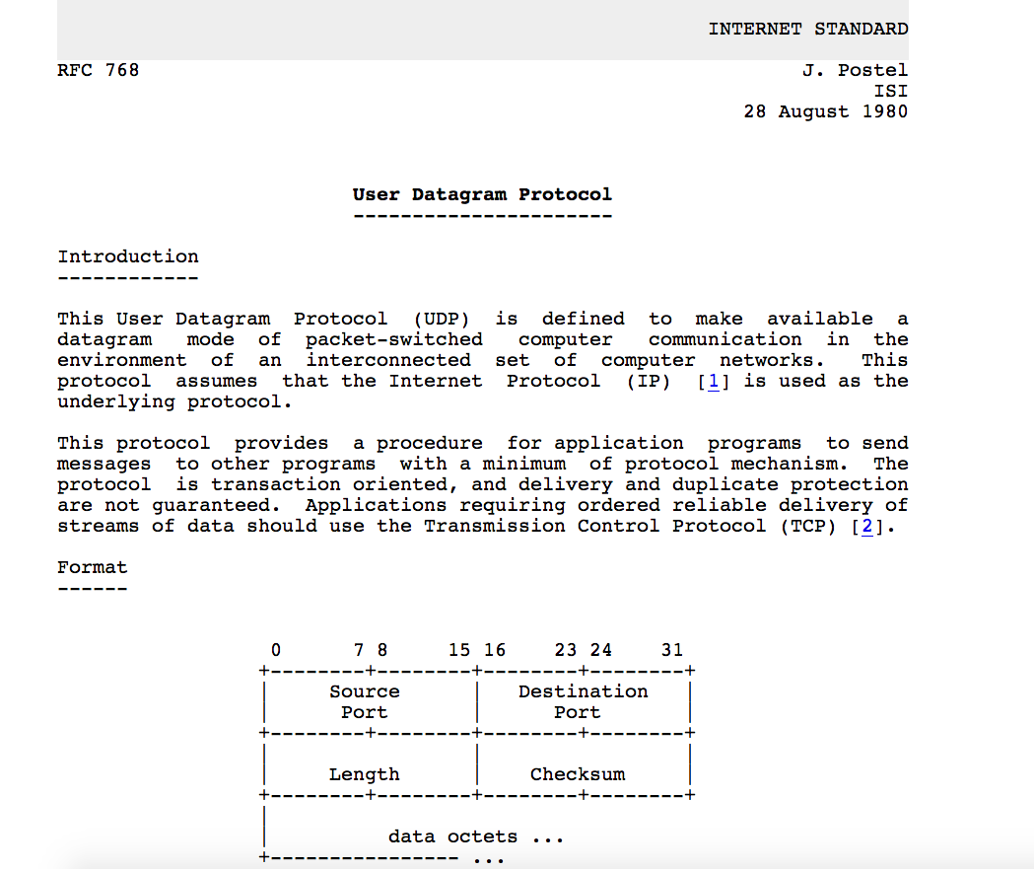
UDP: User Datagram Protocol [RFC 768]
Notes:
read this RFC – it’s only 2.5 pages!

Slide 6
UDP: Transport Layer Actions
SNMP client
SNMP server
application
application
transport
(UDP)
transport
(UDP)
network (IP)
network (IP)
link
link
physical
physical

Slide 7
UDP: Transport Layer Actions
SNMP client
SNMP server
UDP sender actions:
application
application
is passed an application-layer message
SNMP msg
transport
(UDP)
transport
(UDP)
determines UDP segment header fields values
UDP_{h}
SNMP msg
UDP_{h}
creates UDP segment
network (IP)
network (IP)
passes segment to IP
link
link
physical
physical

Slide 8
UDP: Transport Layer Actions
SNMP client
SNMP server
UDP receiver actions:
application
receives segment from IP
application
checks UDP checksum header value
transport
(UDP)
transport
(UDP)
SNMP msg
extracts application-layer message
network (IP)
network (IP)
SNMP msg
UDP_{h}
demultiplexes message up to application via socket
link
link
physical
physical

Slide 9









UDP segment header
32 bits
source port #
dest port #
length
checksum
application
data
(payload)
length, in bytes of UDP segment, including header
data to/from application layer
UDP segment format

Slide 10


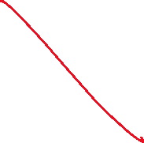




UDP checksum
Goal: detect errors (i.e., flipped bits) in transmitted segment
1st number
2nd number
sum
Transmitted: 5 6 11
Received: 4 6 11
receiver-computed
checksum
=
sender-computed
checksum (as received)

Slide 11
Internet checksum
Goal: detect errors (i.e., flipped bits) in transmitted segment
sender:
treat contents of UDP segment (including UDP header fields and IP addresses) as sequence of 16-bit integers
checksum: addition (one’s complement sum) of segment content
checksum value put into UDP checksum field
receiver:
compute checksum of received segment
check if computed checksum equals checksum field value:
  not equal - error detected
  equal - no error detected. But maybe errors nonetheless? More later ….

Slide 12
Internet checksum: an example
example: add two 16-bit integers
1 1 1 0 0 1 1 0 0 1 1 0 0 1 1 0
1 1 0 1 0 1 0 1 0 1 0 1 0 1 0 1
wraparound
1 1 0 1 1 1 0 1 1 1 0 1 1 1 0 1 1
sum
1 0 1 1 1 0 1 1 1 0 1 1 1 1 0 0
checksum
0 1 0 0 0 1 0 0 0 1 0 0 0 0 1 1
Note: when adding numbers, a carryout from the most significant bit needs to be added to the result
* Check out the online interactive exercises for more examples: http://gaia.cs.umass.edu/kurose_ross/interactive/

Slide 13
Internet checksum: weak protection!
example: add two 16-bit integers
0 1
1 1 1 0 0 1 1 0 0 1 1 0 0 1 1 0
1 0
1 1 0 1 0 1 0 1 0 1 0 1 0 1 0 1
wraparound
1 1 0 1 1 1 0 1 1 1 0 1 1 1 0 1 1
Even though numbers have changed (bit flips), no change in checksum!
sum
1 0 1 1 1 0 1 1 1 0 1 1 1 1 0 0
checksum
0 1 0 0 0 1 0 0 0 1 0 0 0 0 1 1

Slide 14
Summary: UDP
“no frills” protocol:
  segments may be lost, delivered out of order
  best effort service: “send and hope for the best”
UDP has its plusses:
  no setup/handshaking needed (no RTT incurred)
  can function when network service is compromised
  helps with reliability (checksum)
build additional functionality on top of UDP in application layer (e.g., HTTP/3)

Slide 15
Transport layer: roadmap
Transport-layer services
Multiplexing and demultiplexing
Connectionless transport: UDP
Principles of reliable data transfer
Connection-oriented transport: TCP
Principles of congestion control
TCP congestion control
Evolution of transport-layer functionality

Slide 16
Evolving transport-layer functionality
TCP, UDP: principal transport protocols for 40 years
different “flavors” of TCP developed, for specific scenarios:
Scenario | Challenges
Long, fat pipes (large data transfers) | Many packets “in flight”; loss shuts down pipeline
Wireless networks | Loss due to noisy wireless links, mobility; TCP treat this as congestion loss
Long-delay links | Extremely long RTTs
Data center networks | Latency sensitive
Background traffic flows | Low priority, “background” TCP flows
moving transport–layer functions to application layer, on top of UDP
  HTTP/3: QUIC

Slide 17


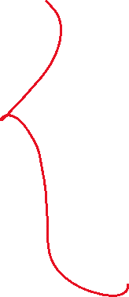
QUIC: Quick UDP Internet Connections
application-layer protocol, on top of UDP
  increase performance of HTTP
  deployed on many Google servers, apps (Chrome, mobile YouTube app)
HTTP/2
HTTP/2 (slimmed)
Application
HTTP/3
TLS
QUIC
Transport
TCP
UDP
Network
IP
IP
HTTP/2 over TCP
HTTP/3 over UDP

Slide 18

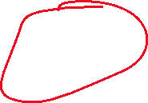
QUIC: Quick UDP Internet Connections
adopts approaches we’ve studied in this chapter for connection establishment, error control, congestion control
  error and congestion control: “Readers familiar with TCP’s loss detection and congestion control will find algorithms here that parallel well-known TCP ones.” [from QUIC specification]
  connection establishment: reliability, congestion control, authentication, encryption, state established in one (or even zero) RTT (recall HTTP3 discussion in Chapter 2)
multiple application-level “streams” multiplexed over single QUIC connection
  separate reliable data transfer, security
  common congestion control

Slide 19

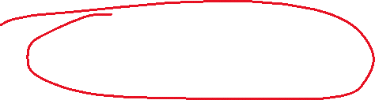
QUIC: streams: parallelism, no HOL blocking
HTTP
GET
HTTP
GET
HTTP
GET
HTTP
GET
HTTP
GET
application
HTTP
GET
QUIC
encrypt
QUIC
encrypt
QUIC
encrypt
QUIC
encrypt
QUIC
encrypt
QUIC
encrypt
TLS encryption
TLS encryption
QUIC
RDT
QUIC
RDT
QUIC
RDT
QUIC
RDT
QUIC
RDT
QUIC
RDT
error!
QUIC Cong. Cont.
QUIC Cong. Cont.
TCP RDT
TCP RDT
error!
transport
TCP Cong. Contr.
TCP Cong. Contr.
UDP
UDP
(a) HTTP 1.1
(b) HTTP/2 with QUIC: no HOL blocking

Slide 20
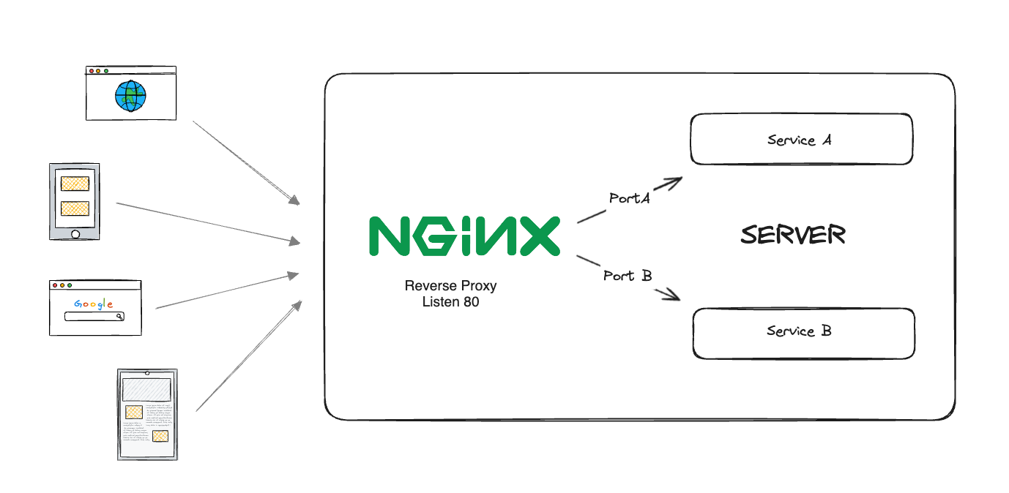
Multiple Web Apps in a Single Server

Slide 21
Loopback Address
127.0.0.1, commonly known as "localhost“.
Key Elements of 127.0.0.1
Loopback Interface: It allows software on the computer to communicate with itself
Local Communication: Any data sent to 127.0.0.1 is looped back to the same computer, meaning it never leaves the device.
Universal Address: 127.0.0.1 is standard across all devices with an IPv4 address, so using it will always point to the local machine.

Slide 22
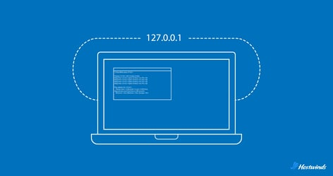
Loopback Address
IPv4 Loopback Range
The entire range of IPv4 loopback addresses go from 127.0.0.0 to 127.255.255.255.
127.0.0.1 is the most commonly referenced.

Slide 23
References
Explaining QUIC: the protocol that is both very similar to and very different from TCP By Peter Door
QUIC Paper
QUIC Paper Overview Video
What is a reverse proxy?
Loopback Address - What is it & How Does it Work?

